Slide 1
A User Study on Robot Skill Learning Without a Cost Function: Optimization of Dynamic Movement Primitives via Naive User Feedback
Friedo, Abou Ghaloun, Bano

Slide 2
Table of Contents
Introduction
Game
Learning Algorithm
Experiment
Simulation
Conduction of Experiment
Results and Data
Difficulties
Demo

Slide 3
Introduction
User-Friendly Robot Learning
Using Dynamic Movement Primitives
Simplifying robot learning for everyday users without precise demonstrations.
User feedback vs. objective cost function
Similar learning performances
Enhanced Human-Robot interaction

Slide 4
Game
Continuous action space
A ball attached to a string and a cup
Pepper gets the ball into the cup

Slide 5
Learning Algorithm
Utilizes dynamic movement primitives (DMP)
Spring damper with forcing term as transformation system
Gating system to make forcing term disappear after convergence
Optimization with Black Box Optimization
Covariance Matrix Evolution Strategy
Locally weighted regression for function approximators
We had to approximate some parameters
Paper has no source code
Experimental Setup wasn’t clear enough on architecture
Radial basis function network instead of LWR approximators

Slide 6
Experiment
Learn from initial trajectory
We used a basic throw trajectory
Created trajectory using dmpbbo package
Regression on data points using dmpbbo
Rollout is simulated using the qiBullet
Matrix of cost_vars
Transformed into a trajectory, that provides radiant values per joint
qiBullet has a setJoints function
Feedback given over terminal input
1-5 from “not good at all” to “very good”
Inverted ratings as cost for minimization

Slide 7
Simulation
Usage of qiBullet to simulate Pepper’s movements
Different values given for joint movements in the arm
Initial Joint movement made manual
RShoulderPitch, RElbowYaw and RElbowRoll
Specify initial and next position for each joint and add speed
Object spawning not possible
New movements after evaluation

Slide 8
Conduction of Experiment
Model 1
Estimated positions
Model 2
Implement sliders into the GUI and export Initial trajectories

Slide 9
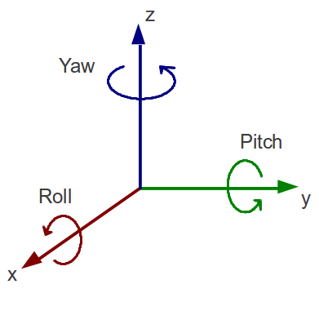
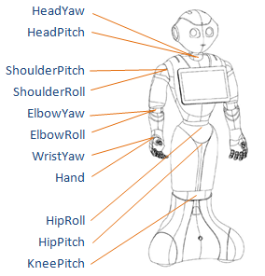
Results 1
n_updates = 8
samples_per_update = 10
5 joints
3 joints
RShoulderPitch, RShoulderRoll, RElbowYaw, RElbowRoll, RWristYaw
RShoulderPitch, RShoulderRoll,
RElbowYaw

Slide 10
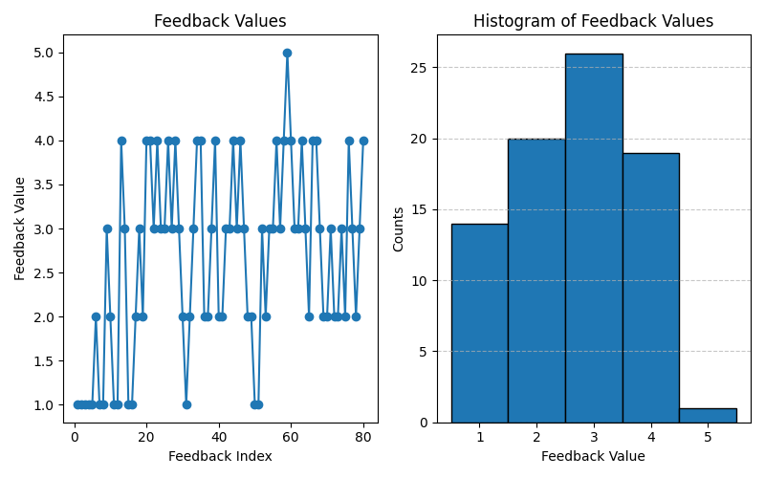
Results 2
Model 2 (5 joints)

Slide 11
Difficulties
Had to create our own trajectory
Couldn’t simulate the game in qiBullet
Paper has no source code
Learning algorithm had to be approximated
dmpbbo is not very well documented/explained

Slide 12
Simulation(qiBullet)
Demo

